Slide 1
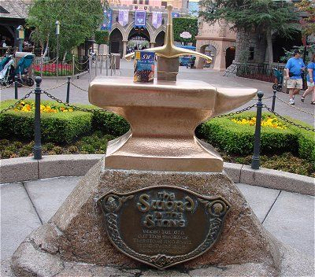

Slide 2
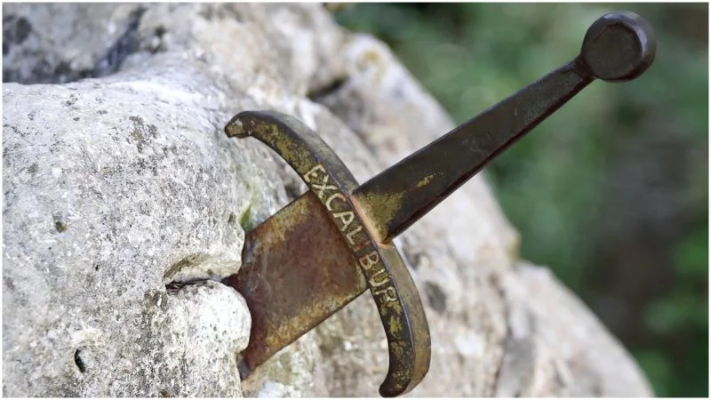

Slide 3
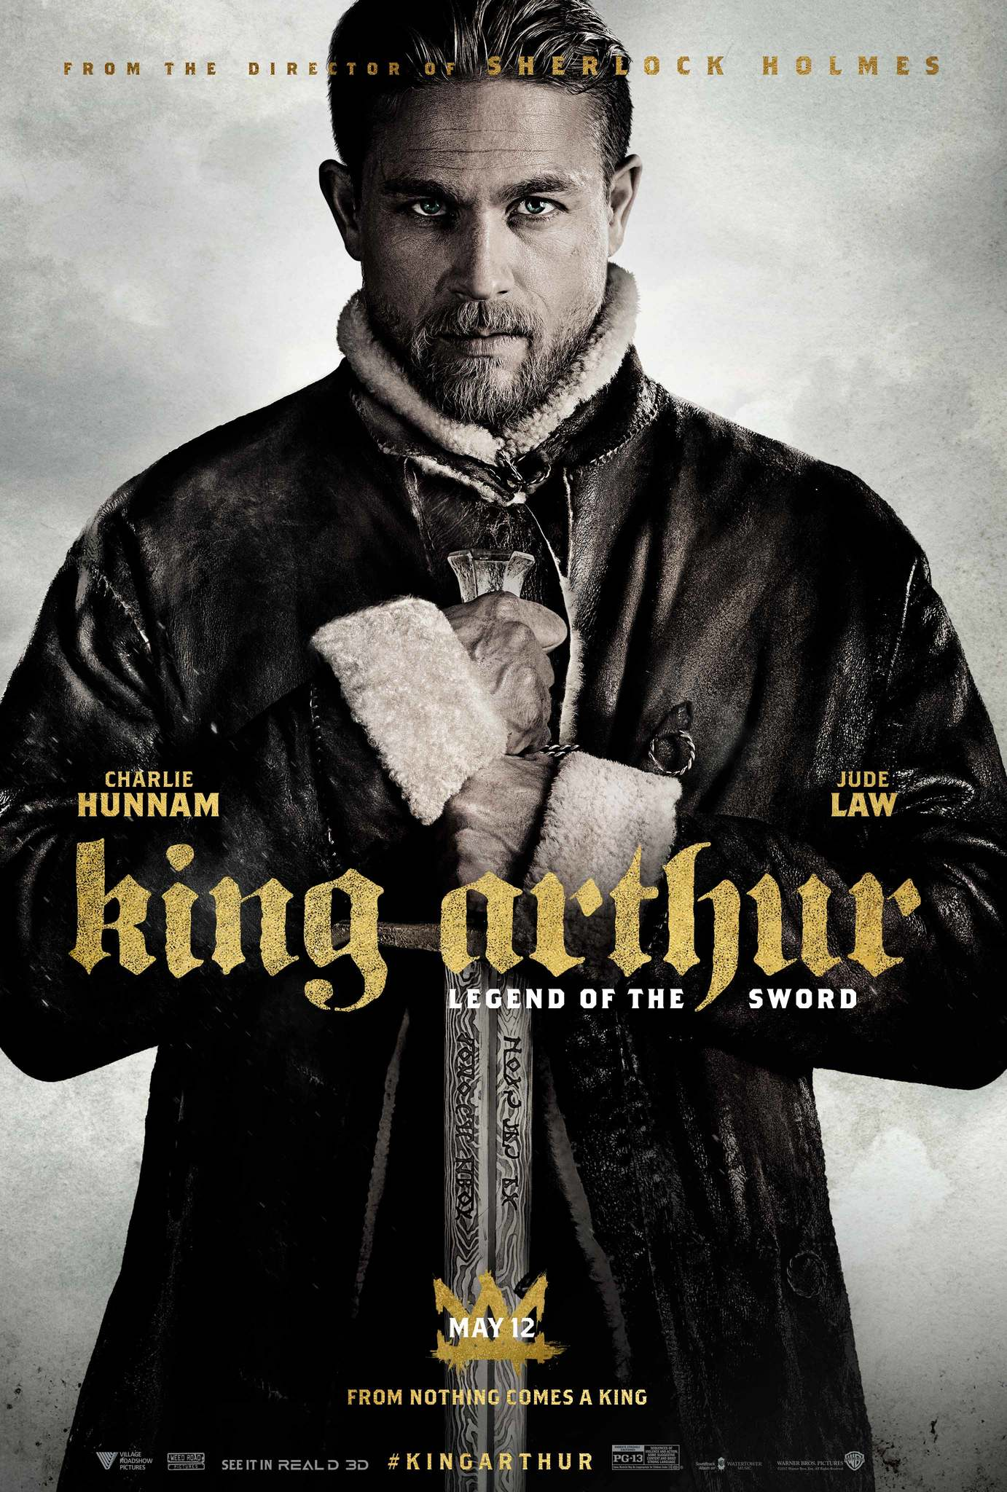

Slide 6
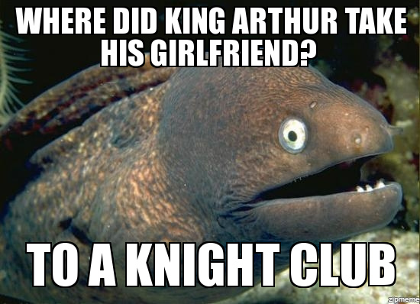

Slide 7
Page 794-795
1. How does the setting of Britain described in the first two paragraphs impact Merlin’s idea to take Uther’s firstborn? What plot event makes Uther willing to take the deal?

Slide 8
Page 796-797
2. What is the plan to choose the king? How do the people feel about it? Use textual evidence to support your answer.

Slide 9
Page 798-799
3. Which character, Sir Kay or Arthur, would the protagonist in your independent novel most identify with? Explain.

Slide 10
Page 800-801
4. Explain the influence of the lost sword on the plot so far. Use evidence from the text to support your answer.
--or--
4. How does Arthur react to pulling the sword? What does that show about the kind of person he is? Justify your reasoning.

Slide 11
Page 802-803
5. What kinds of conflicts do you see in this section. Explain.
(Person vs. person, society, nature, self, fate, supernatural, technology)

Slide 12
804-806
6. What would you say the theme of the story is? How do the characters help show the theme? How does the plot help show the theme? Use details from the text to fully explain your answer.

Slide 13
Page 817-818
Read “He’s No King” on page 817. Do the four multiple choice questions on page 818. You have five minutes, and this is by yourself.
*If you have a teacher’s edition, it should be folded and taped to cover the answers.

Slide 14
In 2 minutes
Write as much as you can about Feudalism, Knights, and Chivalry.

Slide 15
All Record Round Robin
Each person shares, and others write anything they don’t have.

Slide 16
One Stray
One person leaves each group, and visitor shares with the new group. All add to their lists. Group also shares with visitor.

