Slide 1
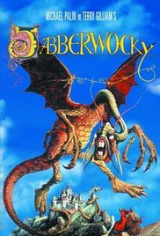
Jabberwocky pg. 459 (red book)
By Lewis Carroll
I can analyze the meaning and structure of a poem.

Slide 2
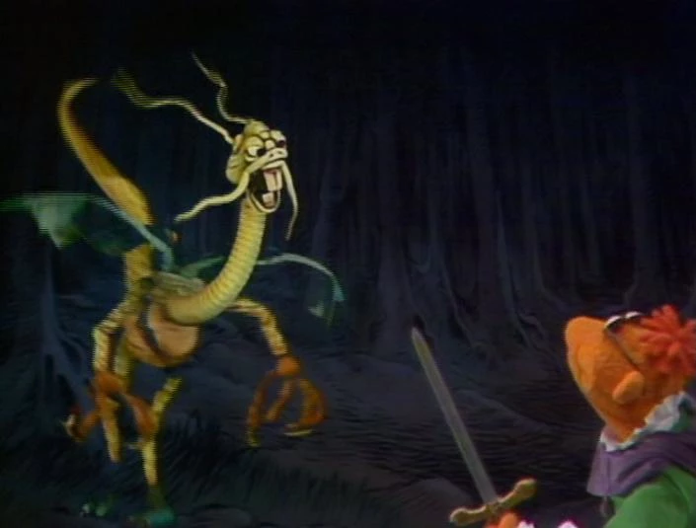
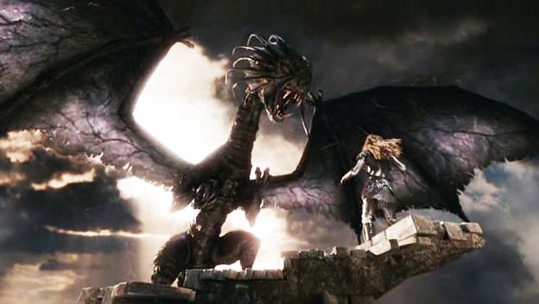
Let’s watch.
https://www.youtube.com/watch?v=LbGbU65_Rbg
https://www.youtube.com/watch?v=b0dhJXUX6I4

Slide 3
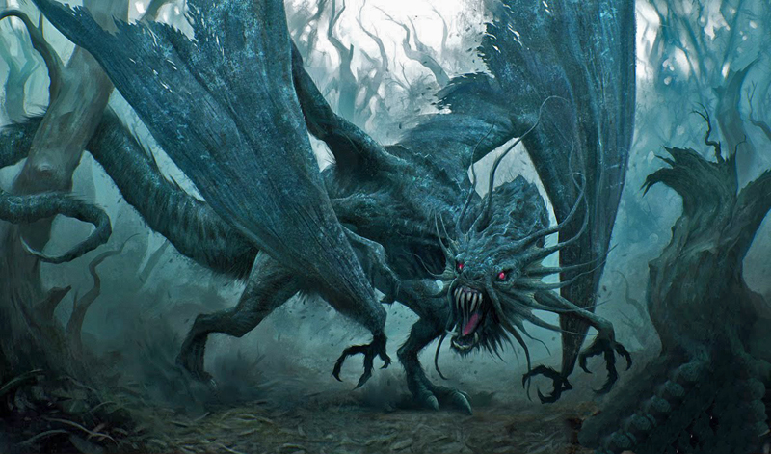
Let’s read Jabberwocky...

Slide 4
Stanza 1 (I can analyze the meaning of a poem.)
Describe the scene in the first stanza. What is the tone of stanza 1? Supply the evidence from the text that supports your answer.

Slide 5
Stanza 2 (I can analyze the meaning of a poem.)
Reread stanza 2. Using the real and nonsense words to explain what is happening.

Slide 6
Stanza 3 (I can analyze the meaning of a poem.)
In stanza 3, who is “he”? What is he doing?

Slide 7
Stanza 4 (I can analyze the meaning of a poem.)
Explain what happens in stanza 4.

Slide 8
Stanza 5 (I can analyze the meaning of a poem.)
Explain what the author means in stanza 5 by, “And through and through/The vorpal blade went snicker-snack.”

Slide 9
Stanza 6 (I can analyze the meaning of a poem.)
In stanza 6, who “chortled in his joy”? Why does he chortle?

Slide 10
Stanza 6 (I can analyze the meaning of a poem.)
Reread stanza 6. What mood is evident in this stanza? Supply the evidence that supports your analysis and thinking.

Slide 11
What about the rhythm in the poem?
4 Quiet people to say “ta”
4 Loud people to say “TUM”

Slide 12
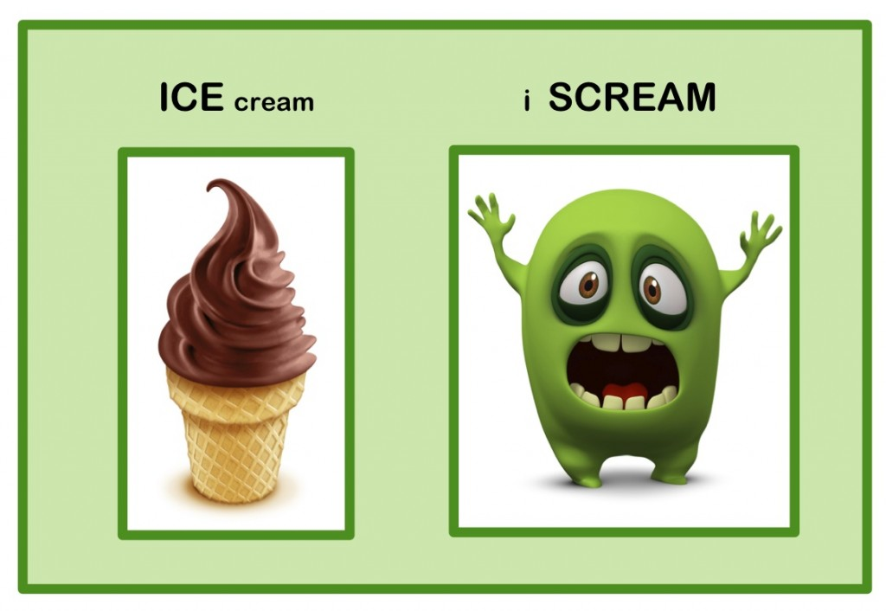

Slide 13
Names...
Who has a name that starts with a stressed syllable?
Who has a name that starts with an unstressed syllable?

Slide 14
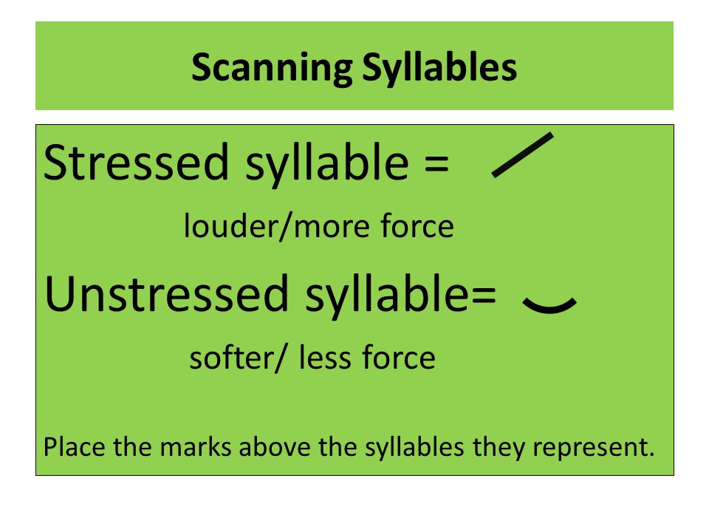
Iambic means an unstressed syllable followed by a stressed syllable.

Slide 15
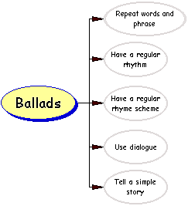
I can analyze the structure of a poem.

